Slide 1


Chris Su
QML REU 2024 – Presentation
Carnegie Mellon University
Mentors: Greg Vetaw, Glen Uehara,
Dr. Suren Jayasuriya, Dr. Andreas Spanias
NSF Award 2349567

Slide 2
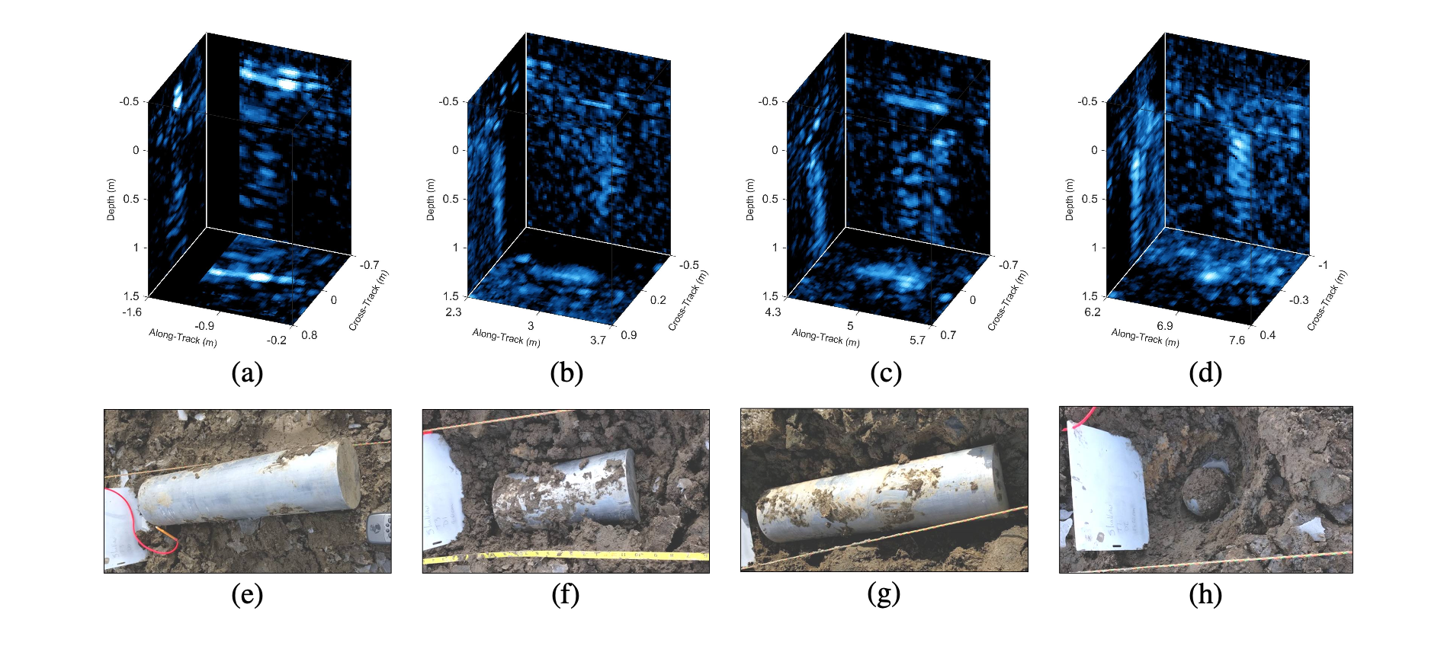
Research Background
3D Synthetic Aperture Sonar Data Cubes targets that mimic underwater ordnances
Want to classify them, but several challenges:
High dynamic range -> Classic range compression techniques may lose important information
Targets return weaker acoustic signals when compared to clutter
Became sort of an “exemplar” problem for a bigger picture of 3D data processing.
3D data processing is understudied, most algorithms are tailored for 2D data
Why?
3D data more expensive to procure, more expensive compute
How can we make it more efficient? (in terms of memory usage, computational efficiency, etc?)

Slide 3
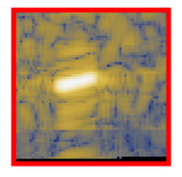
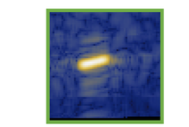
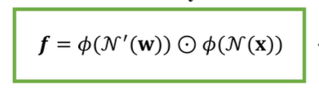
Research Background: Classical Preprocessing (VHN)
(Past works) Intuition / Hypothesis: Tone mapping might help the CNN learn the targets from clutter, so why not make the
tone mapping learnable? Hence, learnable weights are used to tone map (and showed increase in AUC precision recall
metric) [*]
2D Slice
2D Slice
Input
---------------------
---------
-----------
---------
After Volumetric Hadamard
Normalization
Learnable Weights
Log Compressed Input
*Gregory Vetaw, Benjamin Cowen, Daniel C. Brown, David P. Williams, Suren Jayasuriya, “Learning-based Tone Mapping to Improve 3D SAS ATR”, International Geoscience and Remote Sensing Symposium (IGARSS) 2023

Slide 4
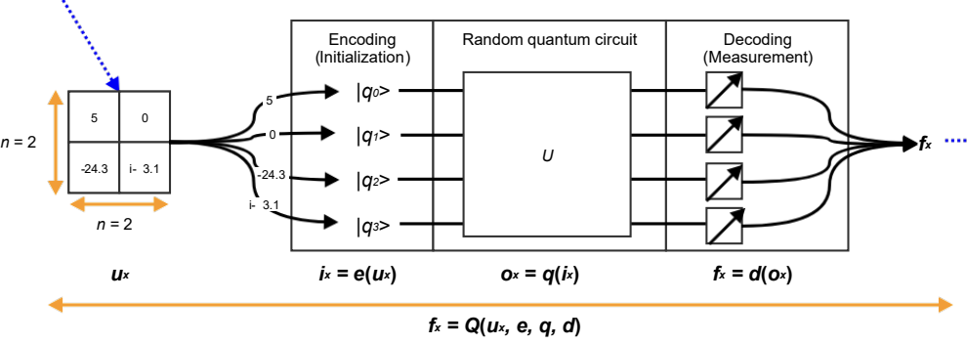
Research Objectives
Can we make a Quantum VHN? (QVHN)
2) Quantum Convolutional Kernels* for 3D Data?
<-------->
Quantum Circuit
*Maxwell Henderson, Samriddhi Shakya, Shashindra Pradhan, Tristan Cook. “Quanvolutional Neural Networks: Powering Image Recognition with Quantum Circuits.”, Arxiv

Slide 5
Making a Quantum VHN: Hadamard Product
-The Hadamard product is an elementwise multiplication of matrices and can be thought of as a
”naïve matrix multiplication”
-Consequently, this generalizes to 3-D and n-D matrices, if they are of the same shape.
-At the root of the Hadamard product is multiplication!
-For our purposes, given our input data cube (represented as a matrix) which is of dimension 64 x 64 x 101 we have a learnable weight matrix of the same dimension which we apply the Hadamard product to
-We use the Hadamard product as a tone mapping operation!
-Can we do this more efficiently in quantum???
Image from wikipedia.com/hadamard_product

Slide 6
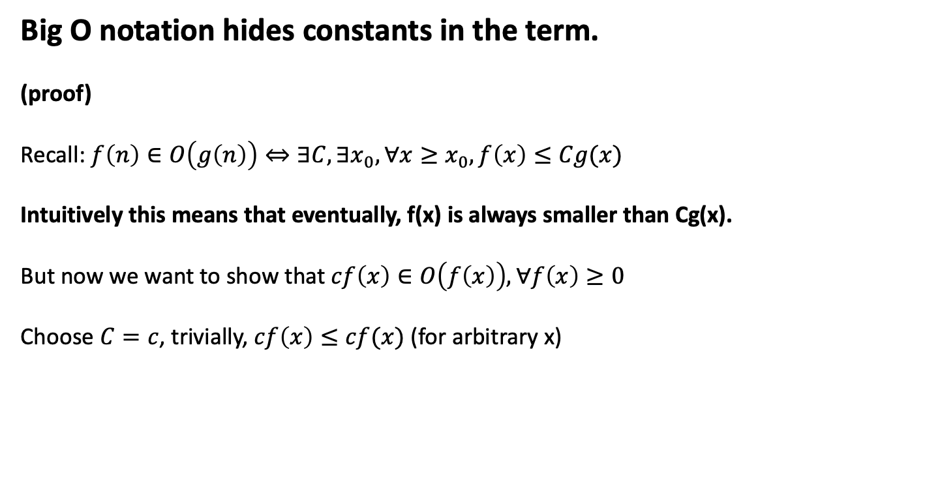
Making a Quantum VHN: Shortcomings of Big O in Practice
Big O notation hides constants in the term.
(proof)
Recall: $f\left(n\right)∈O\left(g\left(n\right)\right)⇔∃C, ∃x_{0}, ∀x≥x_{0}, f\left(x\right)≤Cg(x)$
Intuitively this means that eventually, f(x) is always smaller than Cg(x).
But now we want to show that $cf\left(x\right)∈O\left(f\left(x\right)\right), ∀f\left(x\right)≥0$
Choose $C=c$, trivially, $cf\left(x\right)≤cf(x)$ (for arbitrary x)

Slide 7
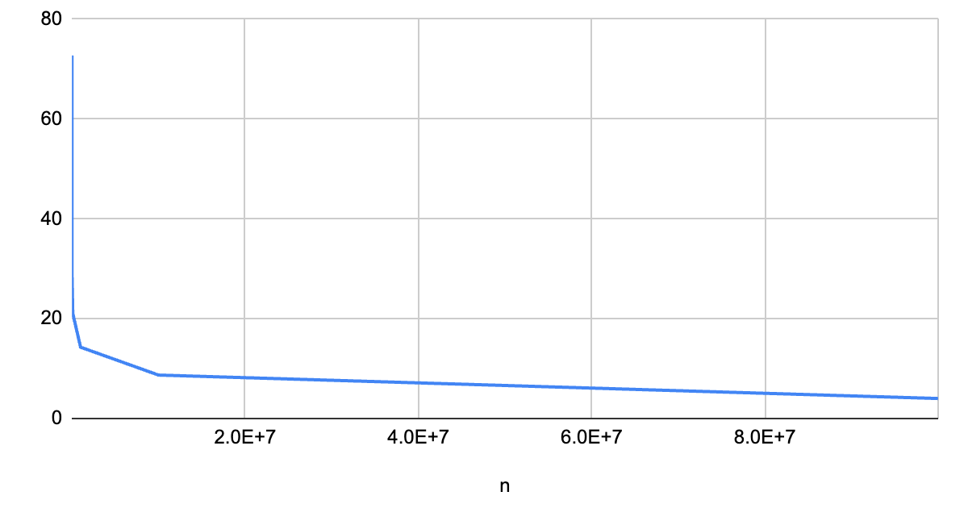
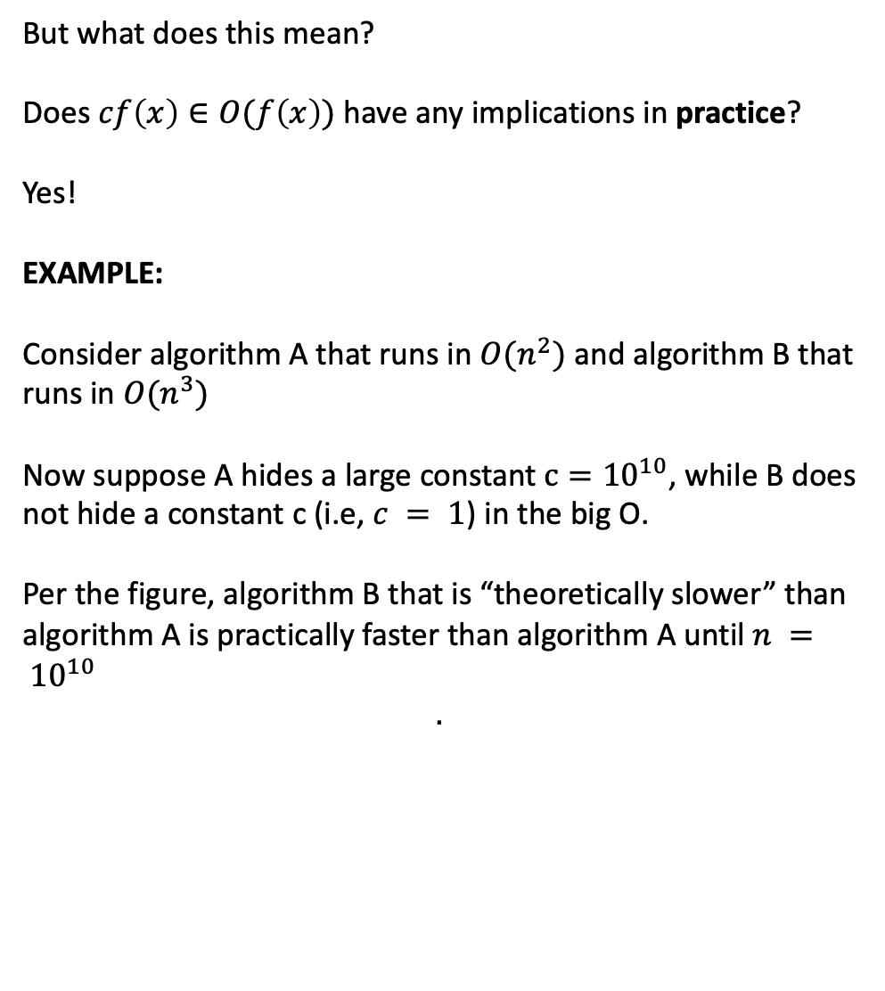
Making a Quantum VHN: Shortcomings of Big O in Practice
But what does this mean?
Does $cf\left(x\right)∈O(f\left(x\right))$ have any implications in practice?
Yes!
EXAMPLE:
Consider algorithm A that runs in $O(n^{2})$ and algorithm B that runs in $O(n^{3})$
Now suppose A hides a large constant$c={10}^{10}$, while B does not hide a constant c (i.e, $c = 1$) in the big O.
Per the figure, algorithm B that is “theoretically slower” than algorithm A is practically faster than algorithm A until $n = {10}^{10}$
$$.$$
Algorithm B vs Algorithm A w.r.t Data input length

Slide 8
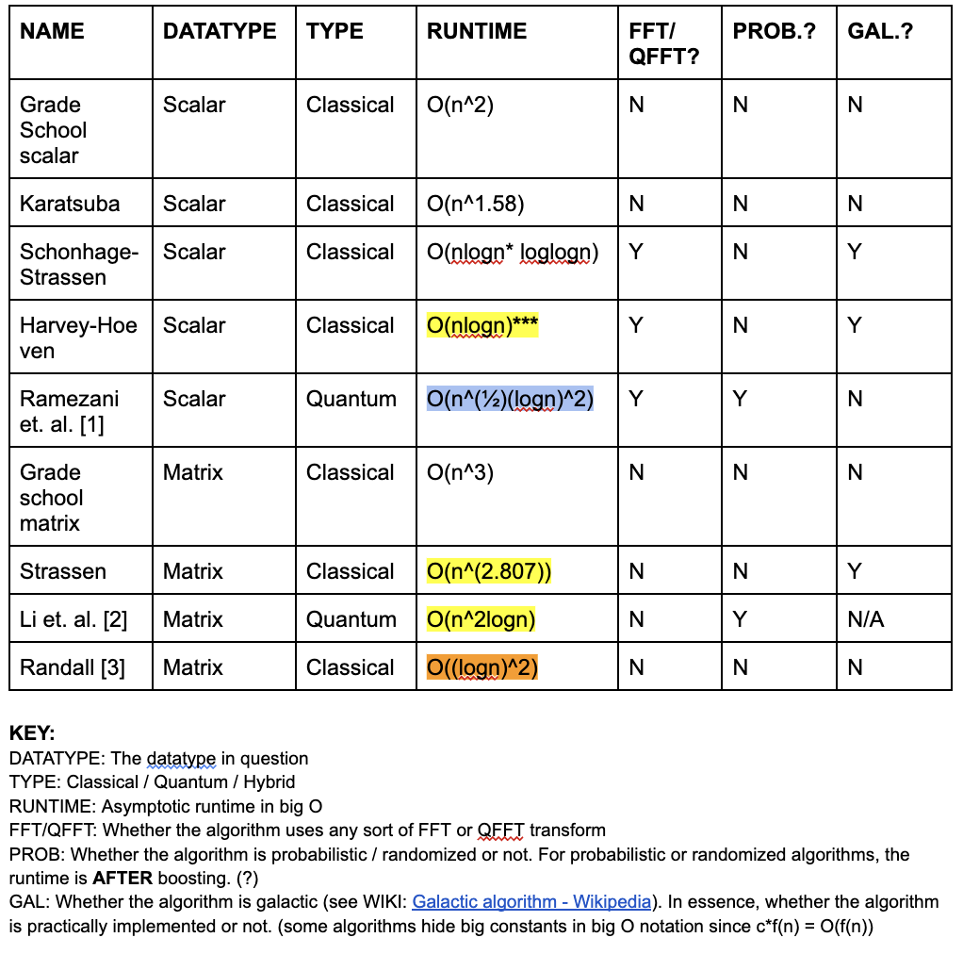
Making a Quantum VHN: Shortcomings of Big O in Practice
Takeaway:
Big O may not be the most informative metric of computational efficiency in practice.
In practice, an “efficient” quantum VHN with applications in ML asks whether we can parallelize multiplication using quantum circuit. We tentatively concluded that such an algorithm is not suitable for a NISQ era but more so when we are able to test practical algorithmic behavior as opposed to comparing complexities.
TLDR: Making a quantum VHN is kind of like comparing apples and oranges

Slide 9
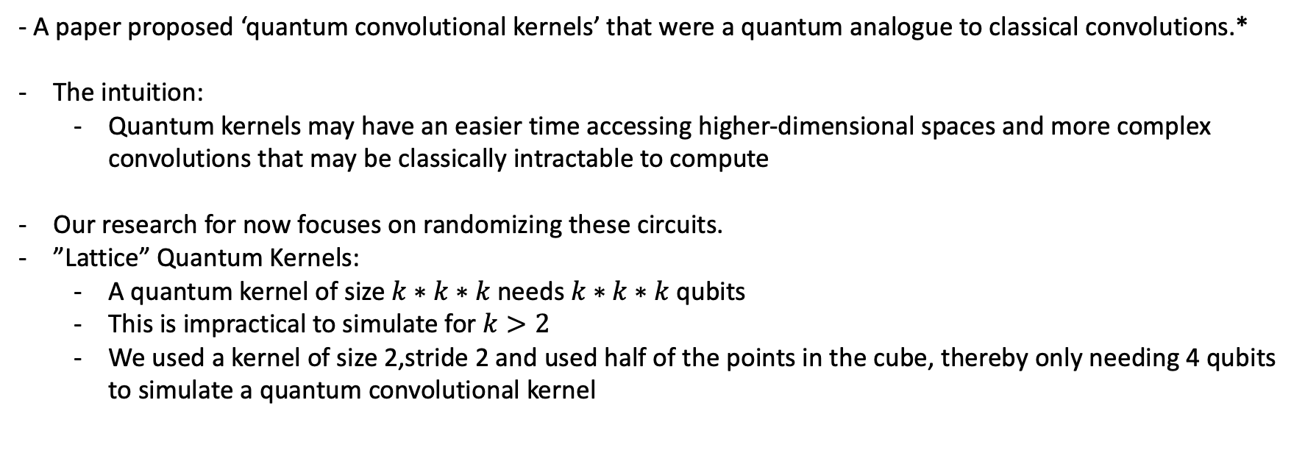
Turning to Quantum Convolutional Kernels
- A paper proposed ‘quantum convolutional kernels’ that were a quantum analogue to classical convolutions.*
The intuition:
Quantum kernels may have an easier time accessing higher-dimensional spaces and more complex convolutions that may be classically intractable to compute
Our research for now focuses on randomizing these circuits.
”Lattice” Quantum Kernels:
A quantum kernel of size$k∗k∗k$needs $k∗k∗k$qubits
This is impractical to simulate for $k>2$
We used a kernel of size 2,stride 2 and used half of the points in the cube, thereby only needing 4 qubits to simulate a quantum convolutional kernel
*
-------
-------
*
*
-------
*
*Maxwell Henderson, Samriddhi Shakya, Shashindra Pradhan, Tristan Cook. “Quanvolutional Neural Networks: Powering Image Recognition with Quantum Circuits.”, Arxiv

Slide 10
SVSS Dataset and CNN Architecture
We used a subset of the original dataset produced by Sediment Volume Search Sonar (SVSS).
Number of classes | 2
Number of targets (Train, Test) | 500, 120
Number of clutter (Train, Test) | 500, 120
Dimensions of cube | 64 x 64 x 101
CPU | Apple M2 arm64
OS | macOS
Memory | 16GB Unified memory
CNN 1, CNN 1 + VHN (Used in classical, Brown et. al*, Vetaw et. al)
CNN 2 (Used with quantum kernels)
3D Conv
3D Avg Pool
3D Conv
3D Avg Pool
3D Conv
FC 1
Output
→
→
→
→
→
→
Figure: CNN 2 Arch.
*Williams and D. Brown, “Three-dimensional convolutional neural networks for target classification with volumetric sonar data,” Proc. of Meetings on Acoustics, vol. 44, p. 070005, Aug. 2021.

Slide 11
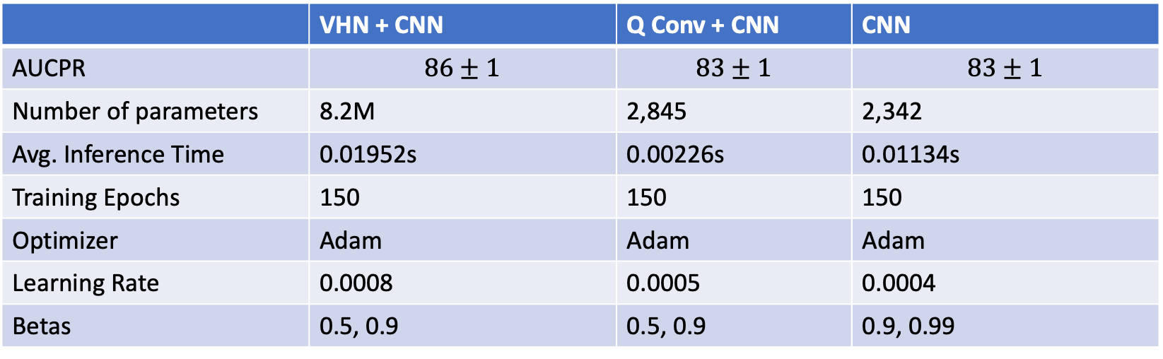
Research Results (Subset of full dataset)
 | VHN + CNN | Q Conv + CNN | CNN
AUCPR | $$86±1$$ | $$83±1$$ | $$83±1$$
Number of parameters | 8.2M | 2,845 | 2,342
Avg. Inference Time | 0.01952s | 0.00226s | 0.01134s
Training Epochs | 150 | 150 | 150
Optimizer | Adam | Adam | Adam
Learning Rate | 0.0008 | 0.0005 | 0.0004
Betas | 0.5, 0.9 | 0.5, 0.9 | 0.9, 0.99
Used the Area Under Curve of Precision Recall metric that helps with imbalanced classes and scores how well the model identifies true positives
A quantum convolutional kernel achieves comparable performance with the baseline CNN, and reduces inference computation time by a factor of 5
Requires less parameters than the VHN + CNN, and reduces inference computation time by a factor of 10

Slide 12
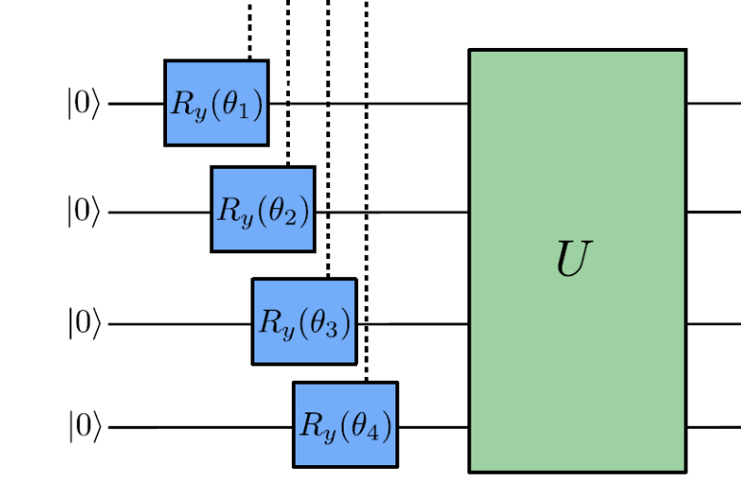
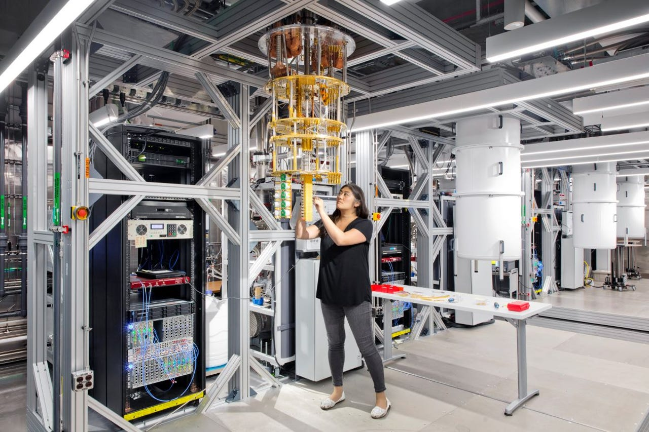
Concluding Remarks / Future Research
Train on larger data with imbalanced data
Use more filters in quantum kernel
Using more filters in convolution neural networks usually increases performance
This was also shown for quantum kernels in the original paper
Our research only used 1 filter so increasing number of filters is the next step
*Images from pennylane, zdnet

Slide 13



Acknowledgements
Special thanks to my mentors Greg Vetaw, Glen Uehara, Dr. Suren Jayasuriya, Dr. Andreas Spanias
Special thanks to Ms. Sayed
Special thanks to NSF for sponsoring the program.

